Slide 1
Rentals Made Easy with RentSpree & WMA
Kimberly Mingo
Sr. Client Success Manager RentSpree

Slide 2
RentSpree simplifies
the entire rental process:
Marketing
Screening
Move-in
Lead Generation
RentSpree: Simplifying the rental process

Slide 3
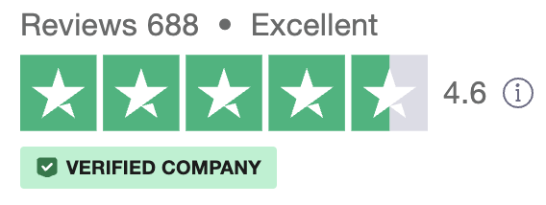
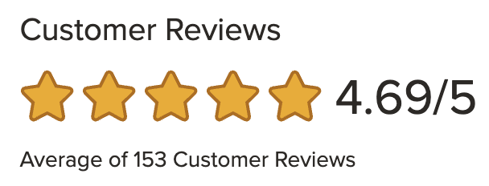
See why customers love us
RentSpree: Simplifying the rental process

Slide 4
Visit link below or scan QR code for more information
www.rentspree.com/partner/wma

Slide 5
Product Demo
RentSpree: Simplifying the rental process

Slide 6
Thank you!
Kimberly Mingo
Sr. Client Success Manager
RentSpree
Special Offer for WMA members.
New accounts created in April will receive 2 FREE Rent Estimate Reports ($40 value)!
support@rentspree.com
323-515-7757

